Slide 1
MIPI DSI
(Mobile Industry Processor Interface Display Serial Interface)

Slide 2
Introduction
The Display Serial Interface (DSI) specification defines protocols between a host processor and peripheral display devices that adhere to MIPI Alliance standards for mobile displays.
MIPI DSI provides a high-speed, low-power serial interface using MIPI D-PHY, enabling efficient transfer of pixel and command data over multiple data lanes with a dedicated clock lane.
The DSI controller includes programmable registers for lane management, timing control, error detection, and interrupt handling. Data is sent in packets (short or long) with ECC/CRC protection over virtual channels.

Slide 3
Features
1 and 2 lane configurations
Unidirectional High-Speed mode transfer (HS-TX)
Bidirectional LP mode transfer/receipt (LP-TX/LP-RX) (Only Lane 0)
ECC/Checksum generation for TX packet
ECC/Checksum verification and ECC error correction for RX packet
Automated power change to LP mode and return to HS mode
Automated clock stop and resume (Non-Continuous Clock mode)
Assignment for virtual channel in Video mode
Assignment for individual virtual channel for each packet in Command mode
Detection for PHY contention error and timeout error
Generation of scrambled packets
Input of TE signal
It operates in Low power, ULPS, HS

Slide 4
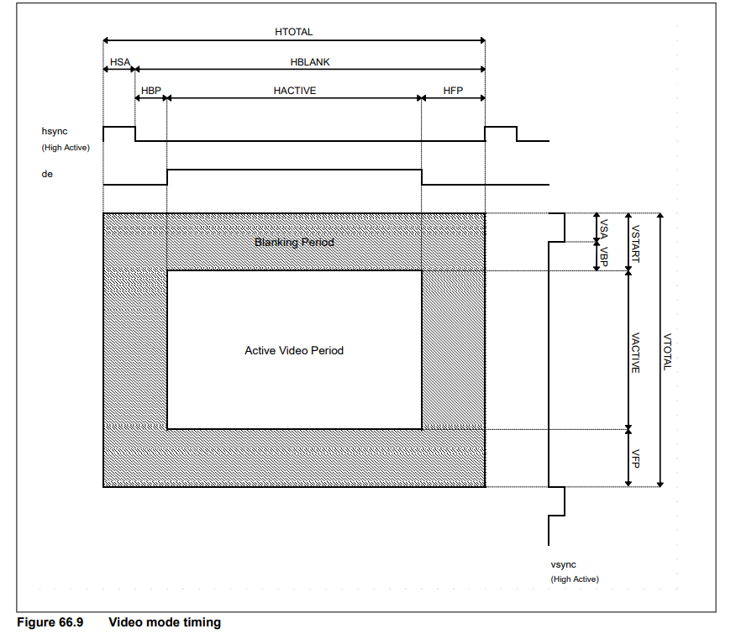
Video mode timing diagram

Slide 5
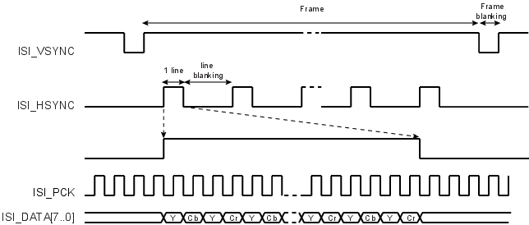

Slide 6
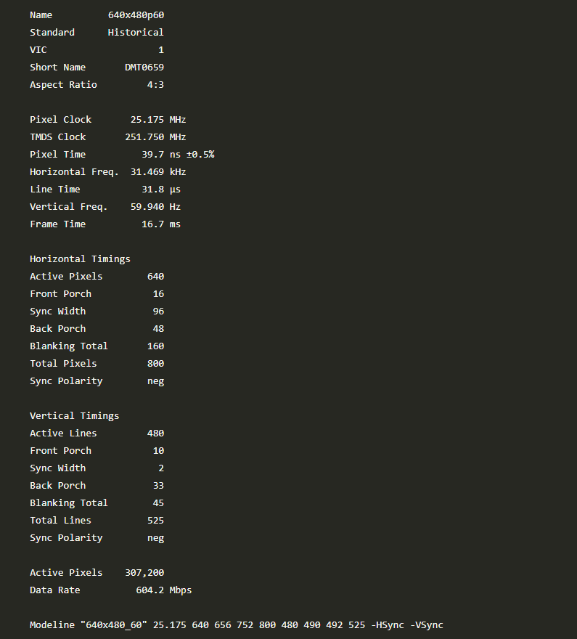

Slide 7
Modes
The interface supports two operating modes:
High-Speed (HS) for video/pixel data mode
- Parallel input format RGB888(24bits),RGB666(18bits),RGB565(16bits)
- Output format RGB (16 bits, 18 bits, 24bits )
- Video mode packet sequence
- Non burst mode with sync pulse
- Non burst mode with sync event
- Burst mode
- Selectable blanking packet or LP-11 during each of blanking interval of HSA, HBP, and HFP
Low-Power (LP) for command and control transfers
- Sequence operation channel 0 : LP-only packet generation and LP packet reception from desriptor list
- Sequence operation channel 1 : HS or LP packet generation and LP packet reception from descriptor list
Interfaces: GLCDC, AHB, PPI

Slide 8
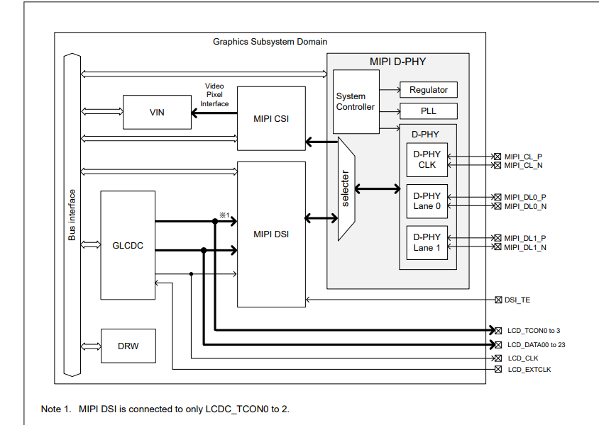
Block Diagram

Slide 9
1. Input Interfaces
a) Display Engine (GLCDC Interface)
-The GLCDC (Graphics LCD Controller) provides pixel data to the DSI Host Controller.
-The data is typically sent as RGB888, RGB666, or RGB101010 format, depending on configuration.
b)Host/Application Processor (AHB Interface)
-The Host CPU accesses the DSI controller through the AHB bus interface.
-It performs register read/write operations to configure the DSI Host
2. Core Operation – DSI Host Controller
-The DSI Host Controller is responsible for:
-Packet generation
-mode management
-lane management
-clock control
-protocol timing control
3. PPI
Converts parallel data from the DSI Host into differential high-speed signals compliant with the MIPI D-PHY specification.

Slide 10
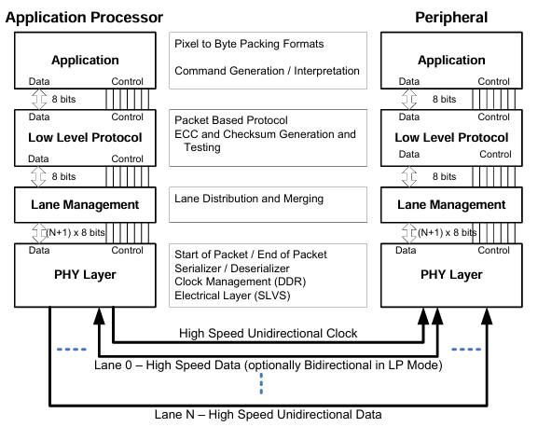

Slide 11
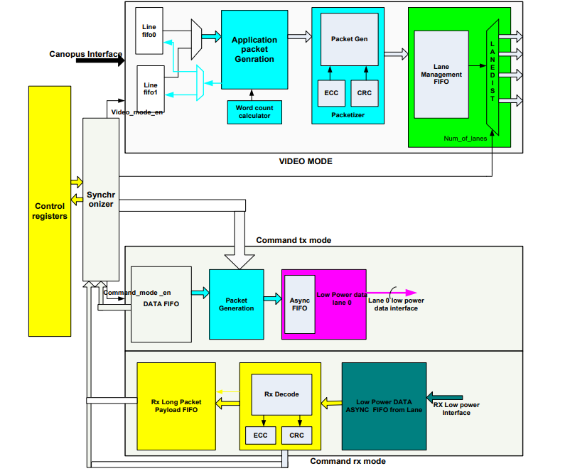
Functional diagram of DSI Controller

Slide 12
Control Registers
Holds configuration and status registers accessible via AHB interface
Used for command/video mode setup, pixel format, and timing configuration.
Line FIFO (0,1)
Dual line buffers for storing pixel data from GLCDC (Display Engine).
Supports asynchronous clocks (Pixel vs DSI clock).
Video Mode Application / Packet Generation
Reads pixel data from FIFO and generates MIPI long packets per frame timing.
Word Count Calculator
Calculates payload byte count based on pixel format and active resolution.
Packetizer
Generates MIPI-compliant short and long packets with ECC (header) and CRC (payload).
Ensures data integrity before transmission to Lane Manager.
Lane Manager
Interfaces with D-PHY through PPI (PHY Protocol Interface).
Distributes data across lanes in HS mode and handles LP mode on Lane 0.

Slide 13
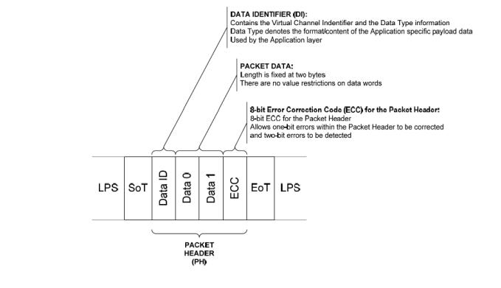
Short packet

Slide 14
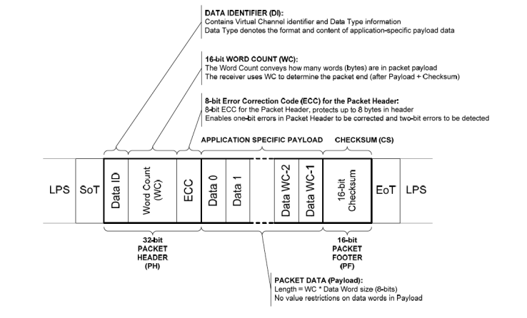
Long Packet

Slide 15
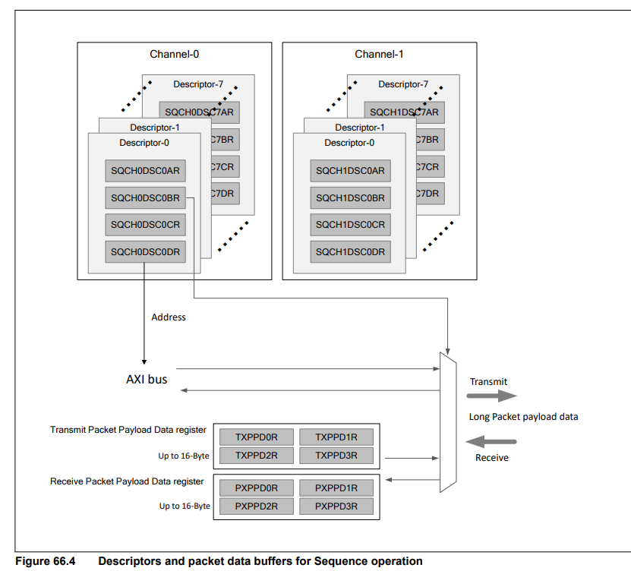

Slide 16
1. Dual Channel Structure
The DSI Host supports two independent sequence channels:
- Channel-0 (SQCH0)
- Channel-1 (SQCH1)
2. Descriptor-Based Operation
Each channel has eight descriptors (Descriptor-0 to Descriptor-7).
Every descriptor contains a set of control and address registers:
- SQCHxDSCOAR – Descriptor Command Operation Address Register
- SQCHxDSCOBR – Descriptor Command Operation Byte Count Register
- SQCHxDSCOCR – Descriptor Command Operation Control Register
- SQCHxDSCODR – Descriptor Command Operation Data Register
3. AXI Bus Interface
All descriptors access memory through the AXI bus.
4. Packet Payload Data Registers
The controller includes dedicated Packet Payload Data Registers:
-Transmit Packet Payload Data Registers (TXPPDxR) – up to 16 bytes.
-Receive Packet Payload Data Registers (PXPPDxR) – up to 16 bytes.
.

Slide 17
5. Data Flow Transmit Path Receive Path 6. Channel Functions Channel-0: Typically handles Low-Power (LP) command sequences. Channel-1: Can operate in HS or LP modes, supporting both command and video sequence operations.

Slide 18
Single Packet Transmission
In the non-read packet transmission, set the following registers before sending the packets.
SQCHnDSCmAR.NXACT[1:0] : 00b
SQCHnDSCmAR.FMT : 0 (Short packet) or 1 (Long packet)
SQCHnDSCmAR.SPD : 0 (High speed) or 1 (Low speed)
SQCHnDSCmAR.BTA[1:0] : 00b (without BTA) or 01b (with BTA)
SQCHnDSCmAR.VC[1:0]
SQCHnDSCmAR.DT[5:0]
SQCHnDSCmAR.DATA0[7:0]
SQCHnDSCmAR.DATA1[7:0]
SQCHnDSCmBR.DTSEL[1:0] : Specify where to store the payload data for the non-read
packets
00b: TXPPDxR (x = 0 to 3). Payloads size is limited up to 16 bytes.
01b: Memory space. Payloads size is limited up to 4 KB.

Slide 19
After the above settings, send a non-read packet by setting the SQCHnSET0R.START bit to 1. When single packet transmission is complete, the SQCHnSR.ADESFIN bit is set to 1
When the SQCHnDSCmAR.BTA[1:0] bits are set to 01b, BTA takes place after sending a non-read packet.
After DSI Host gives bus ownership to the peripheral, an ACK trigger message or an Acknowledge and Error Report packet may be returned from the peripheral.
You can get a summary of the reception result by reading the RXRSSxR register with the number x specified in the SQCHnDSCmCR.ACTCODE[7:0] bits, and you can get the reception result details by reading the RXSR register

Slide 20
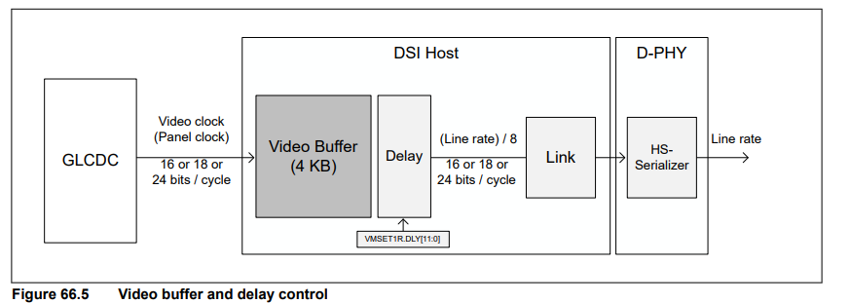
Delay adjustment for video mode

Slide 21
- The DSI Host has a 4 KB video buffer to input video stream from GLCDC.
- It is necessary to use the VMSET1R.DLY[11:0] bits to adjust the delay time for reading from the video
buffer to prevent the video buffer from overflowing or underflowing during Video mode operation.
- The delay time is derived from the following formula:
Delay time [µs] = VMSET1R.DLY[11:0] × (period of HS serial UI) [µs] × 32

Slide 22


